Slide 1
Complexity: data

Slide 2
Extraction

Slide 3
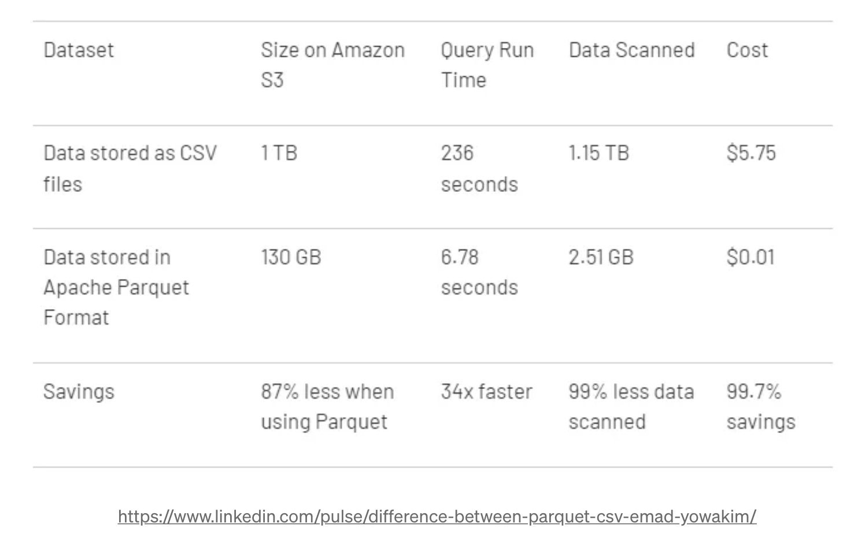
Data formats
CSV > parquet

Slide 4
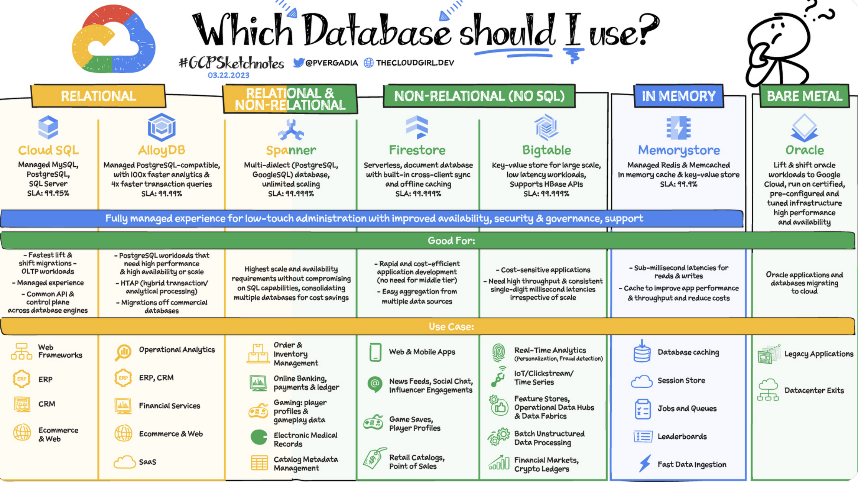
Storage
Bucket
SQL DB
NoSQL DB

Slide 5
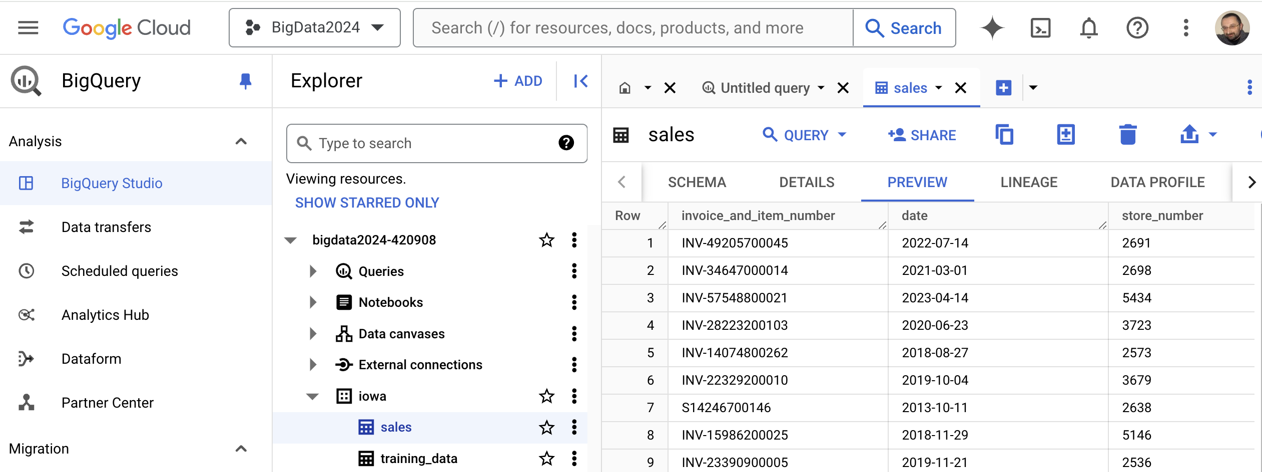
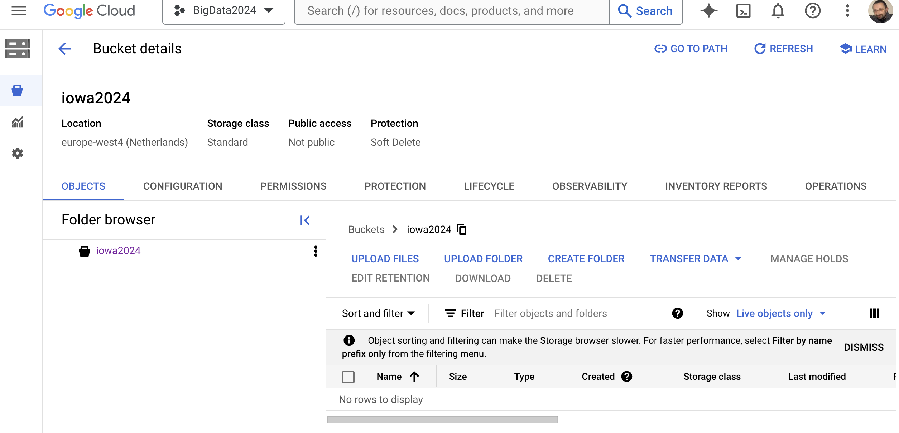
Storage
Bucket
SQL DB
NoSQL DB

Slide 6
Processing

Slide 7
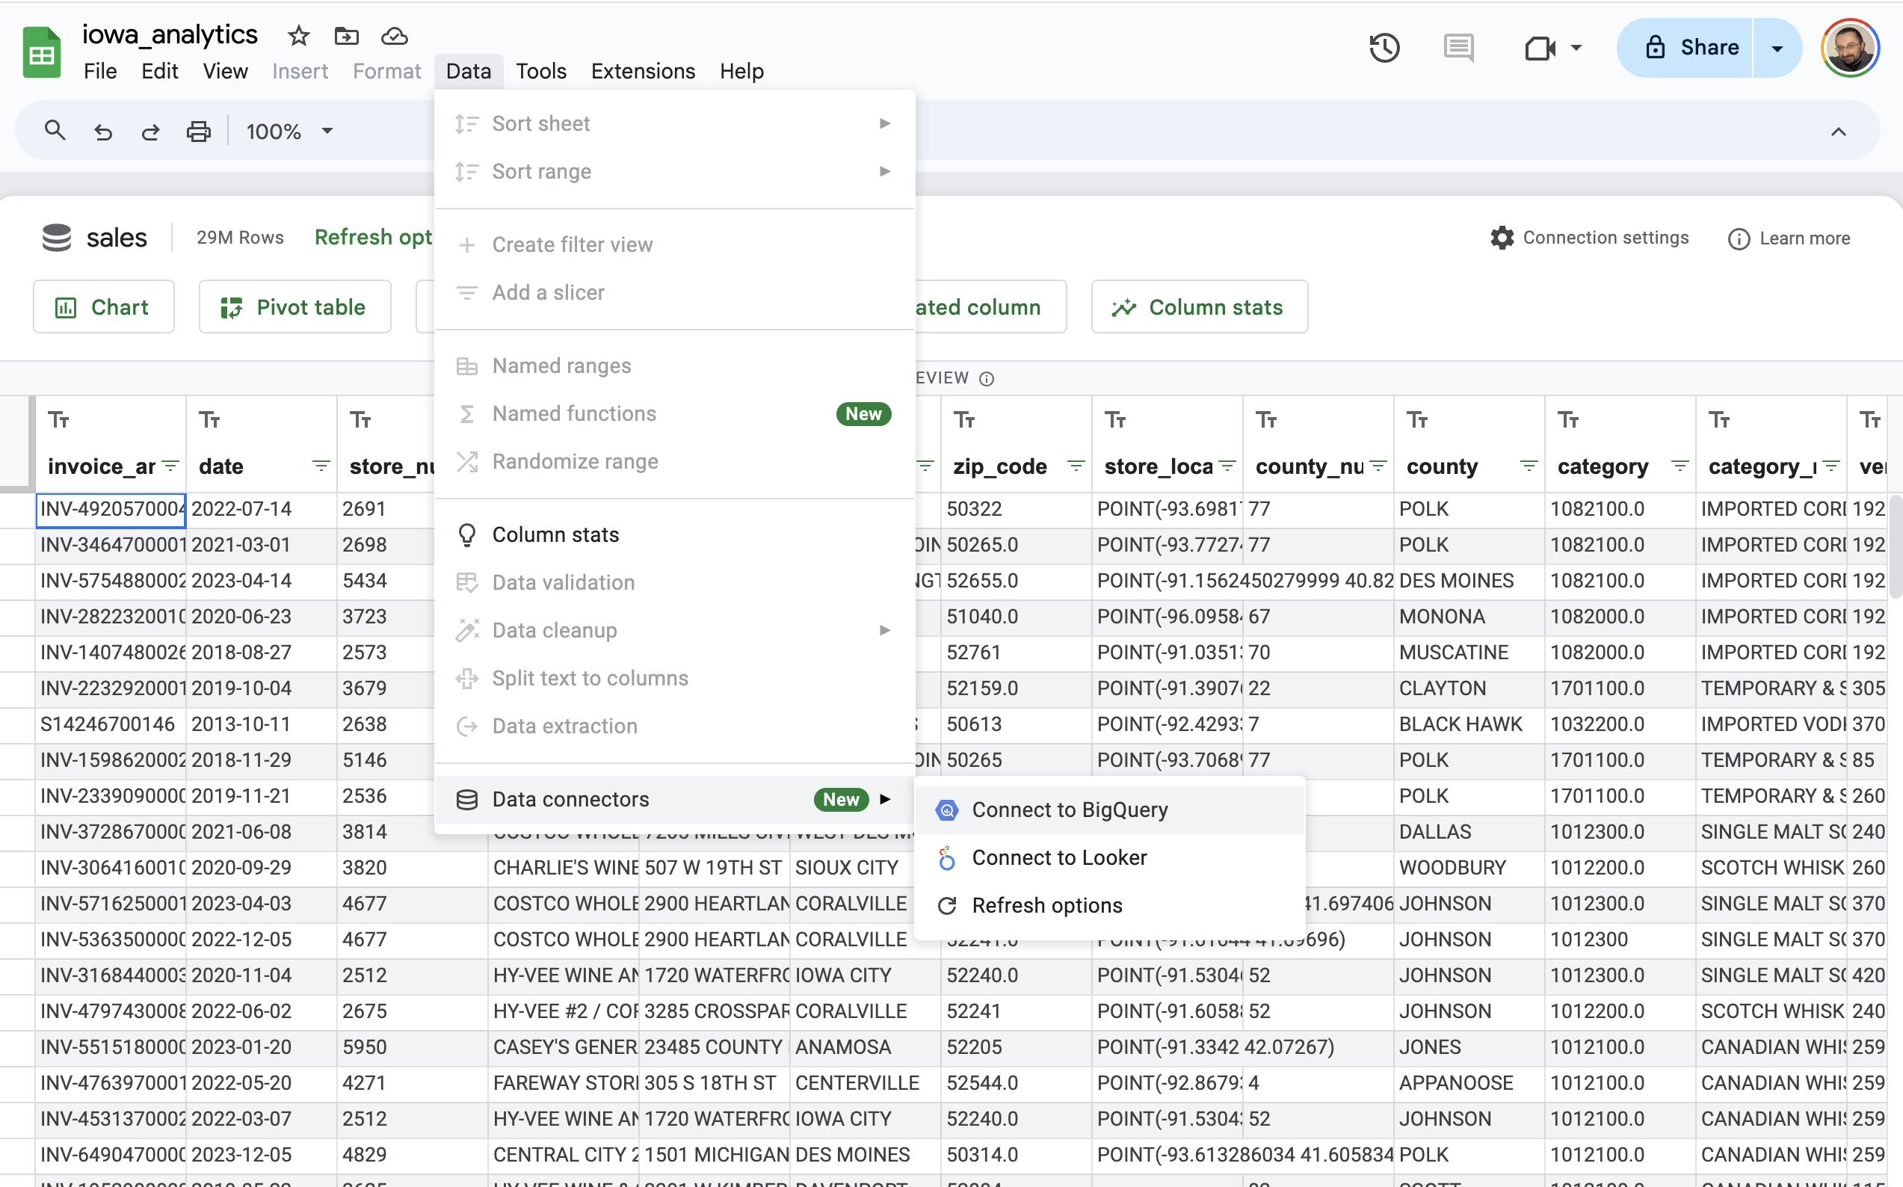

Slide 8
1
Data transformation
Data preparation
2
Feature engineering

Slide 9
SELECT
invoice_and_item_number,
date,
store_number,
item_description,
bottles_sold,
sale_dollars
FROM
`bigdata2024-420908.iowa.sales`
LIMIT
5
SQL
simple report

Slide 10
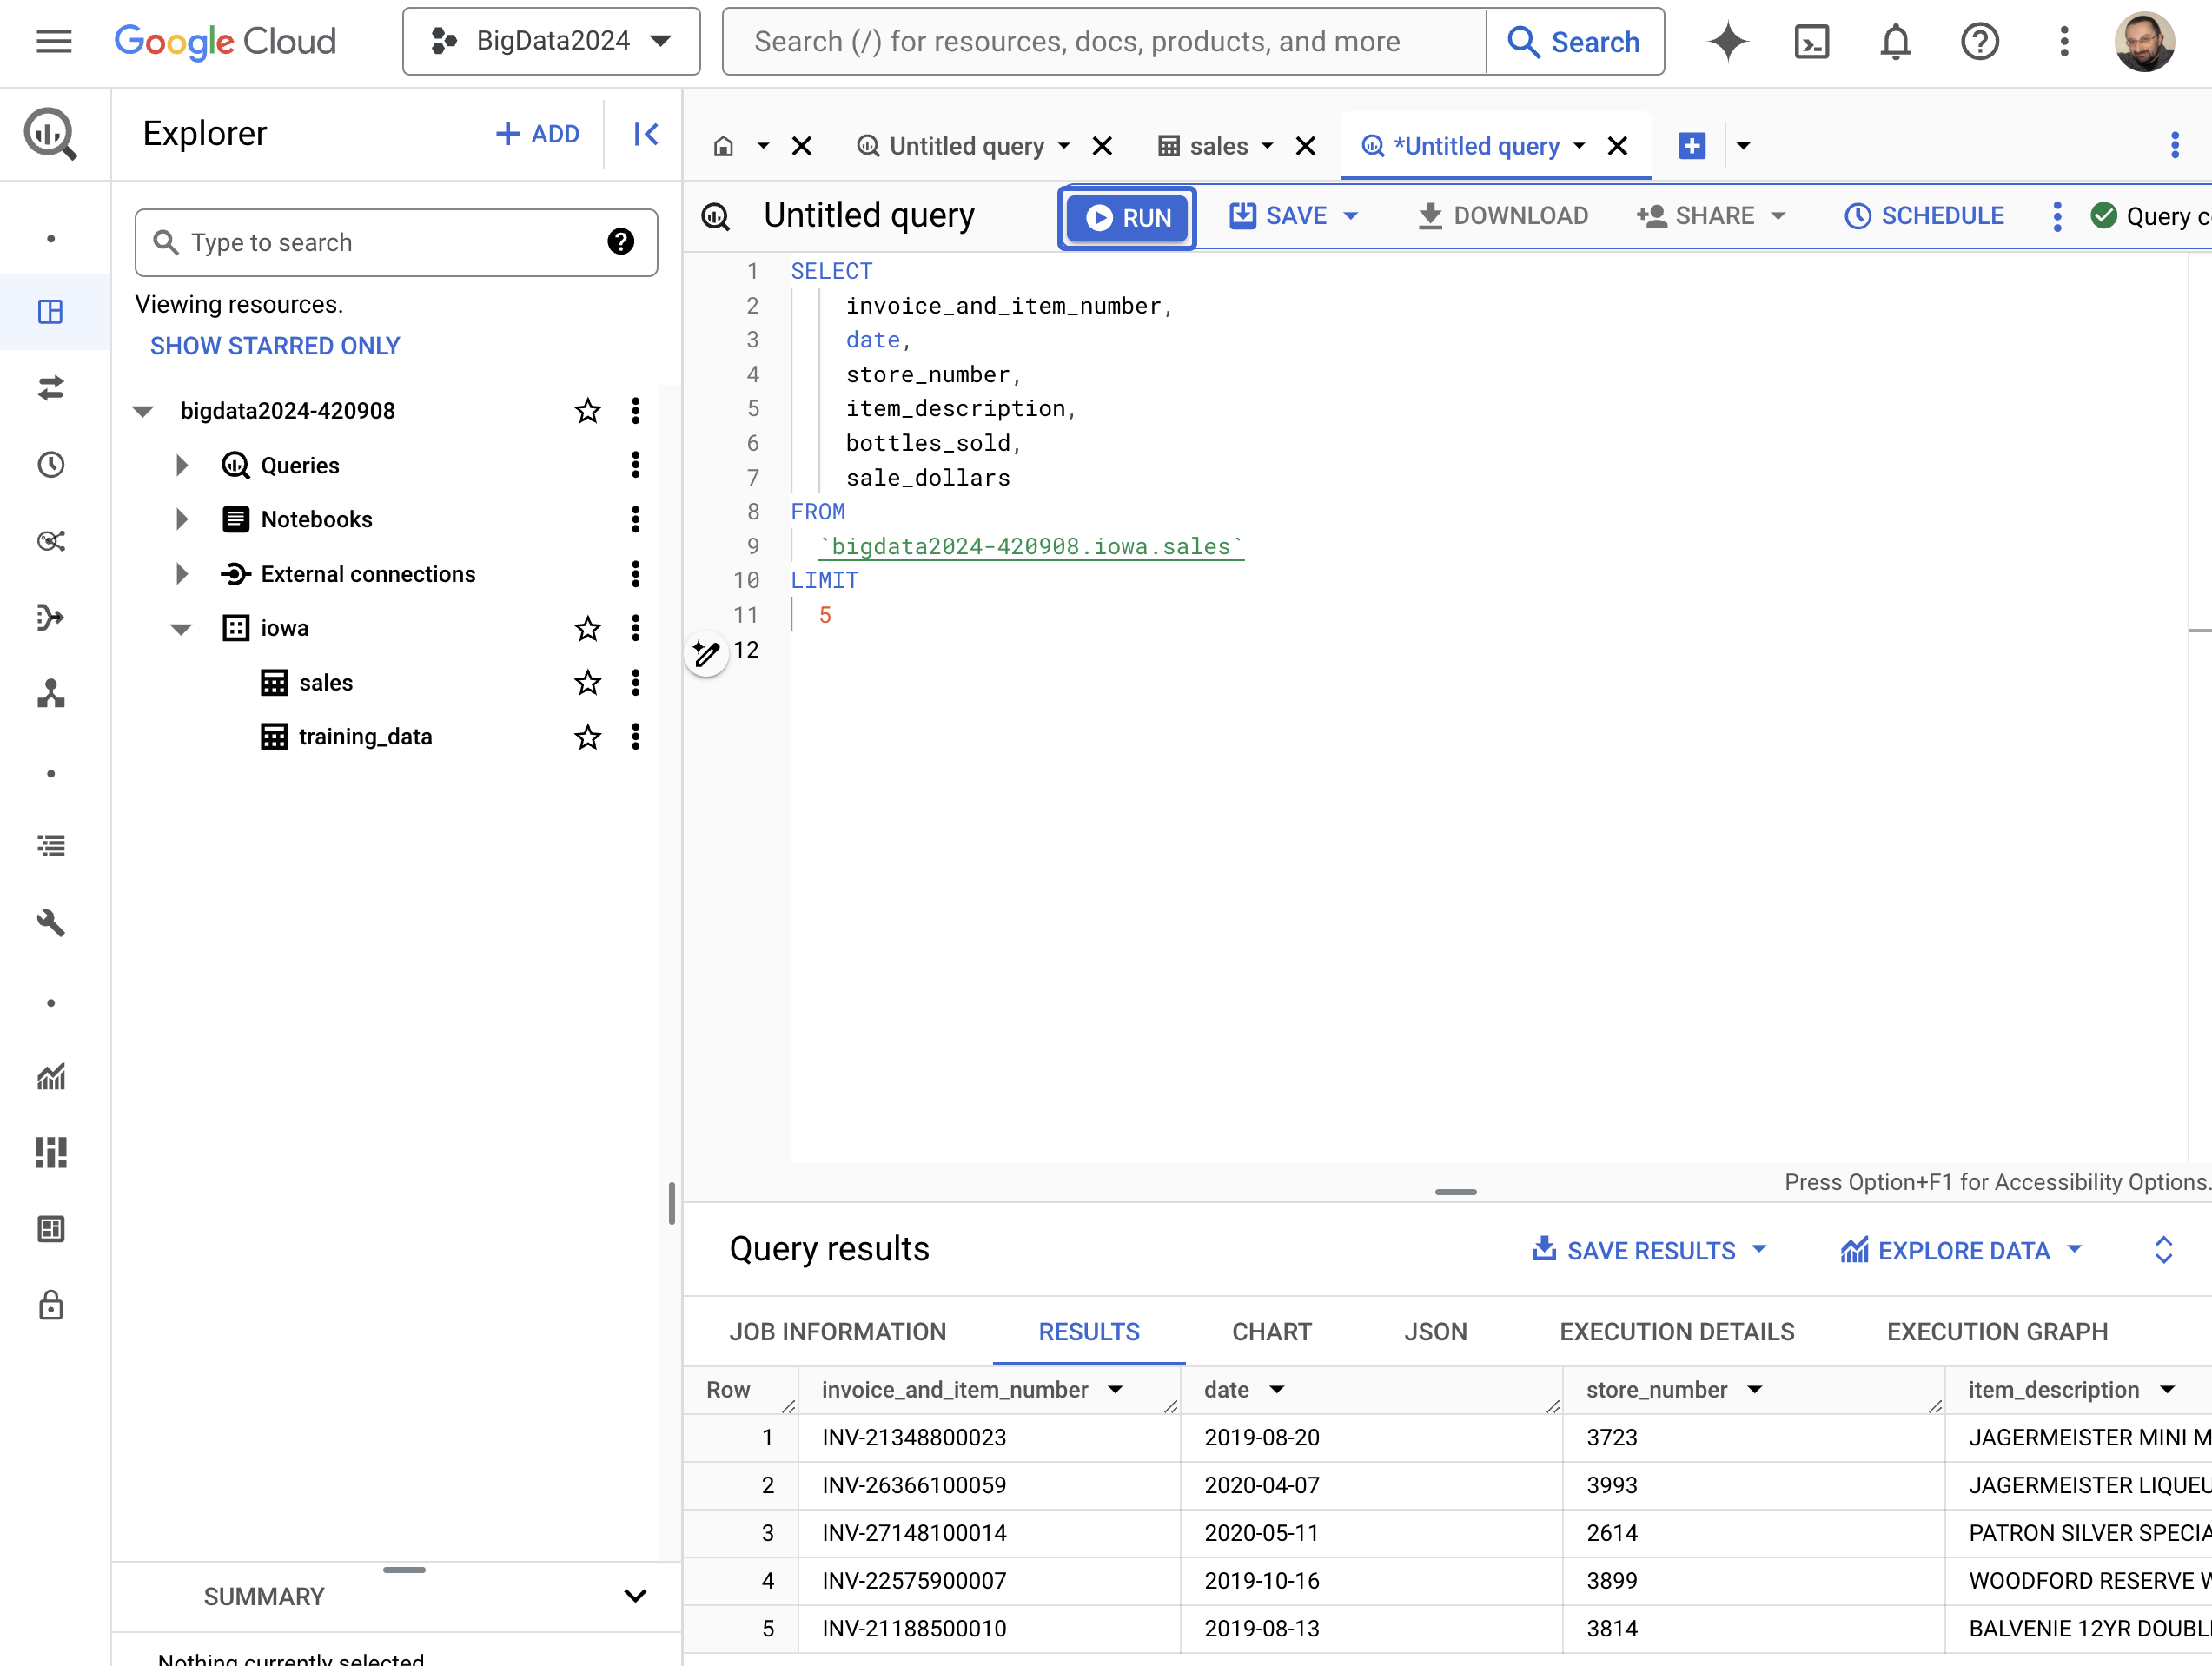
SQL
implementation

Slide 11
CREATE OR REPLACE TABLE iowa.training_data AS (
WITH topsellingitems AS(
SELECT
item_description,
count(item_description) cnt_transactions
FROM
`bigdata2024-420908.iowa.sales`
GROUP BY
item_description
ORDER BY cnt_transactions DESC
LIMIT 5 #Top N
)
SELECT
date,
item_description AS item_name,
SUM(bottles_sold) AS total_amount_sold
FROM
`bigdata2024-420908.iowa.sales`
GROUP BY
date, item_name
HAVING
date BETWEEN '2023-01-01' AND '2024-03-29'
AND item_description IN (SELECT item_description FROM topsellingitems)
);
SELECT
date,
item_name,
total_amount_sold
FROM
iowa.training_data
ORDER BY item_name, date
LIMIT 10
SQL
New table creation

Slide 12
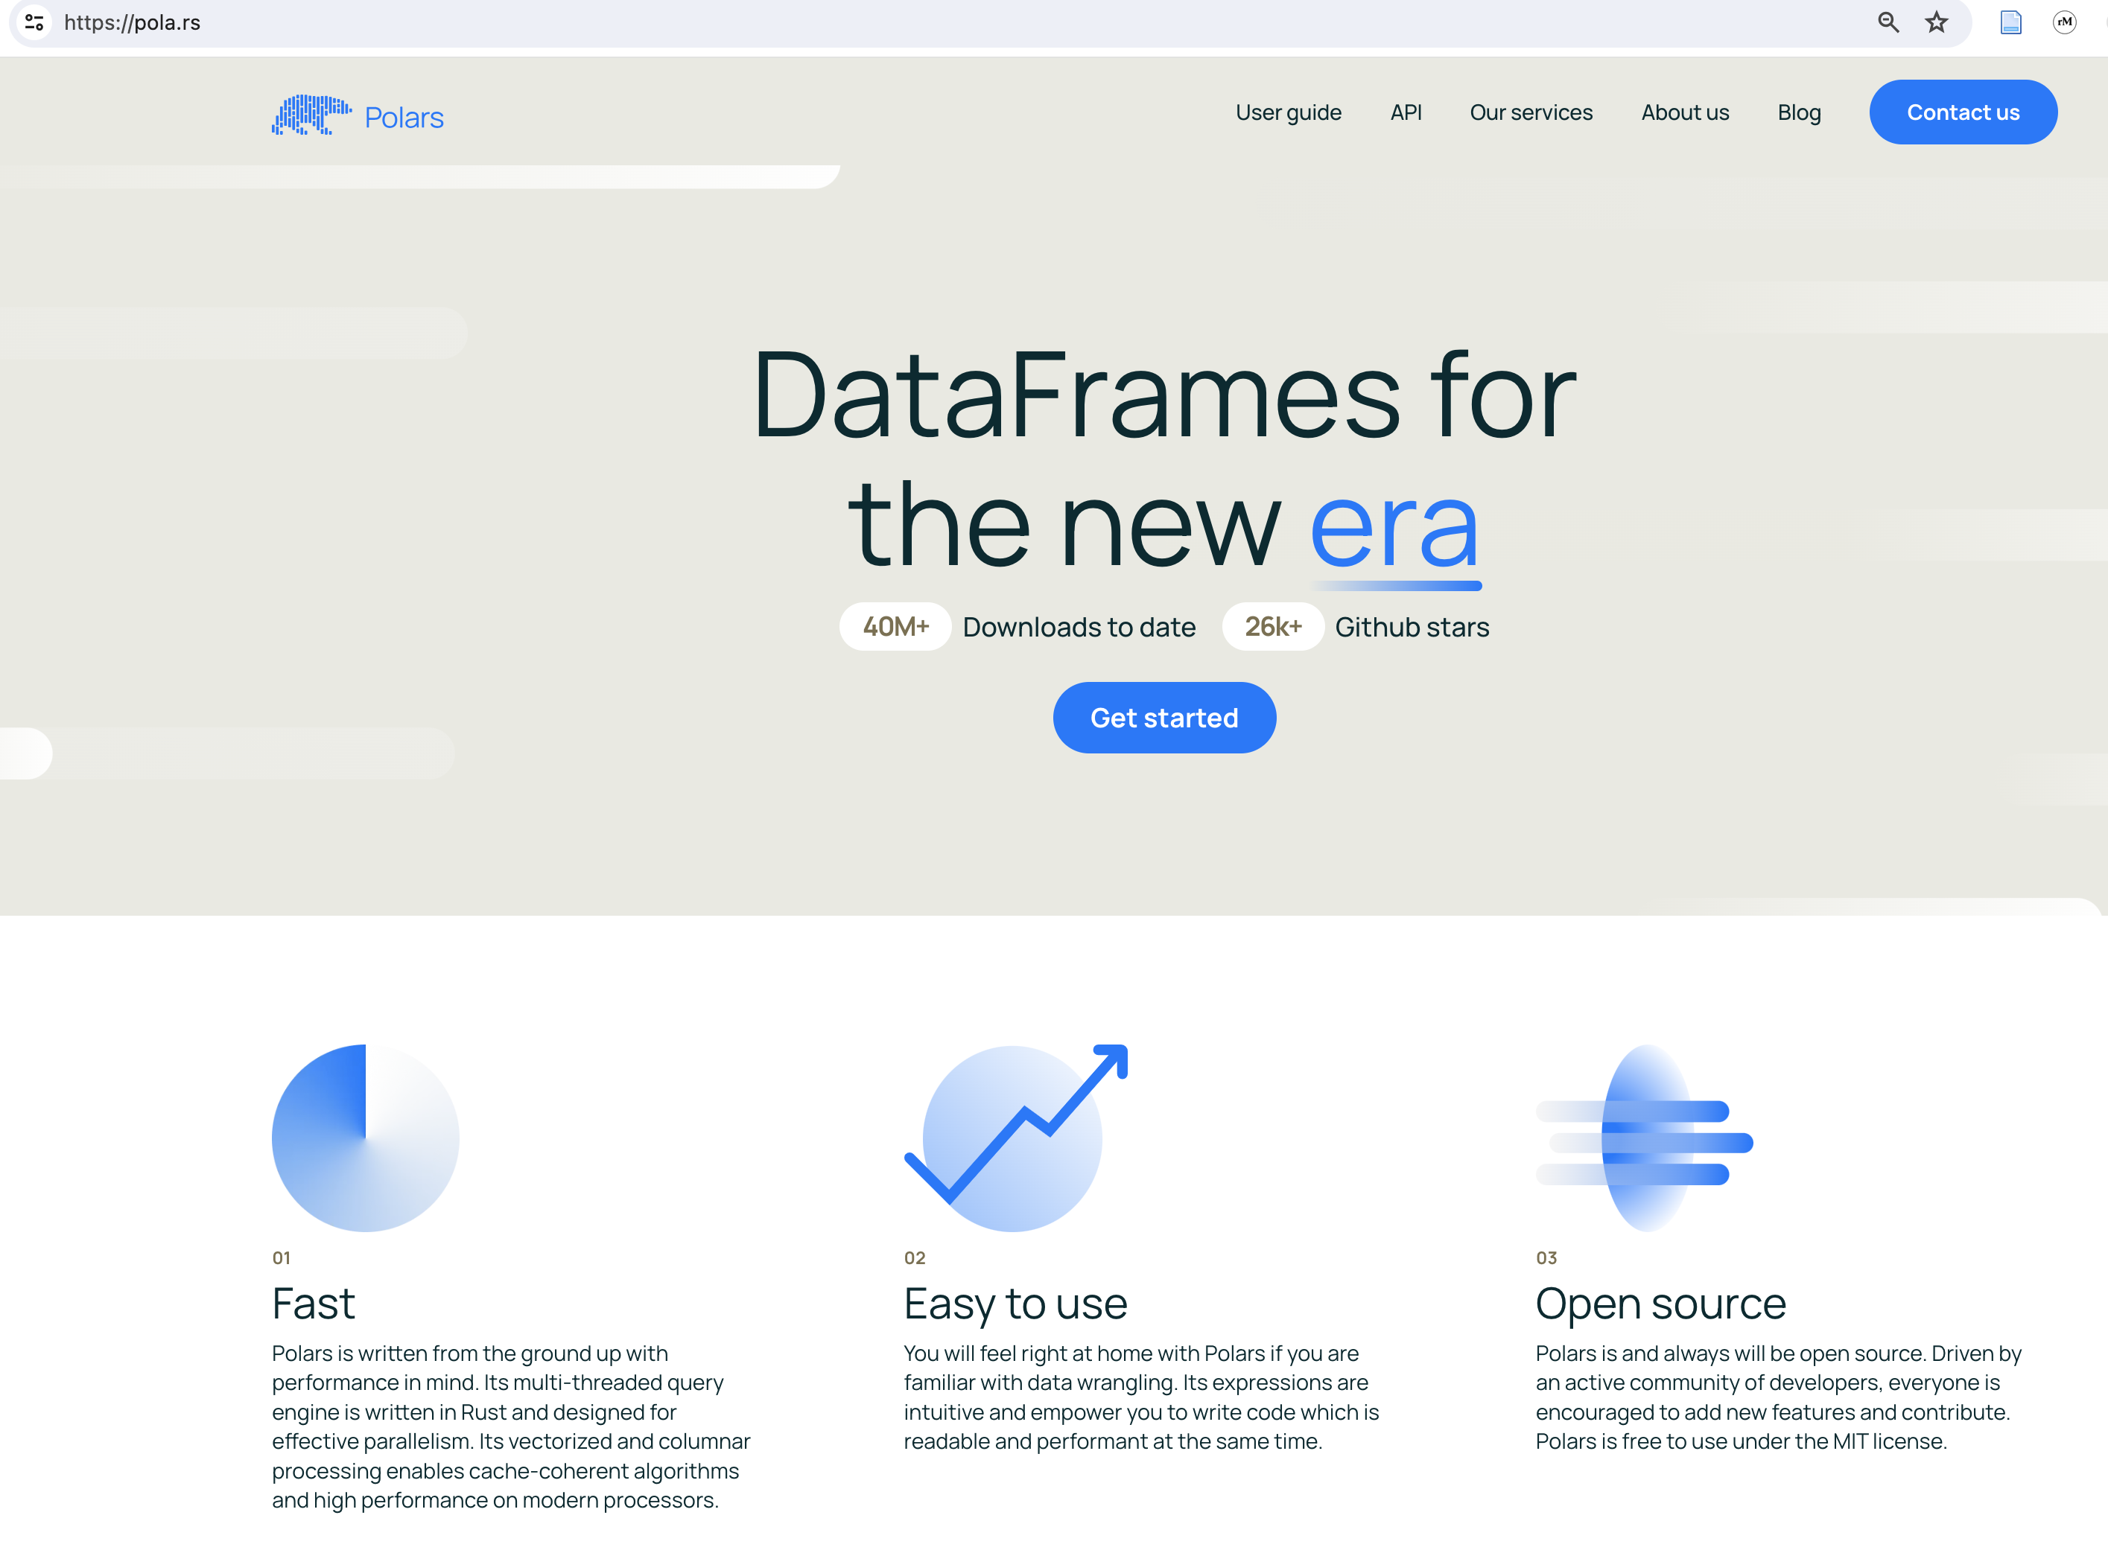

Slide 13
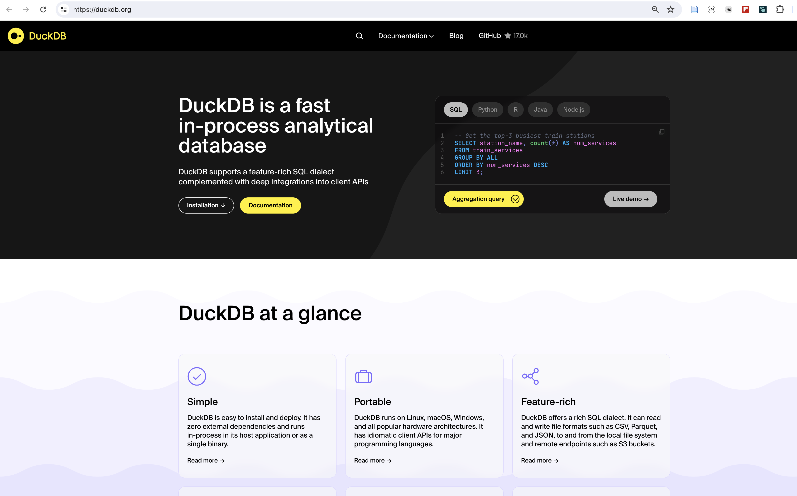

Slide 14
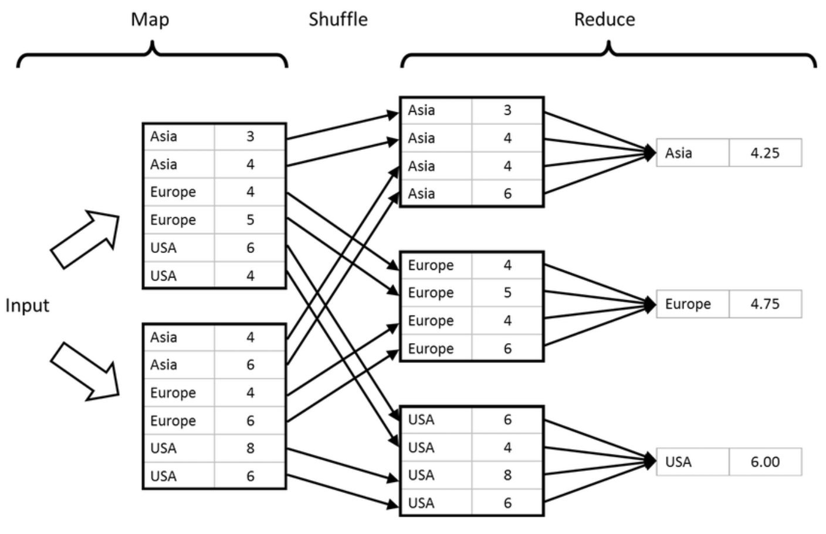
Map {Shuffle} Reduce

Slide 15
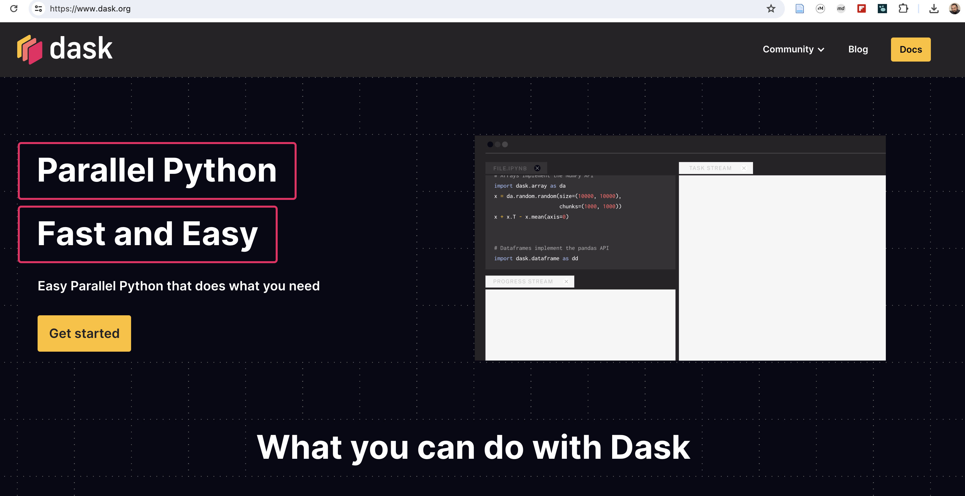

Slide 16
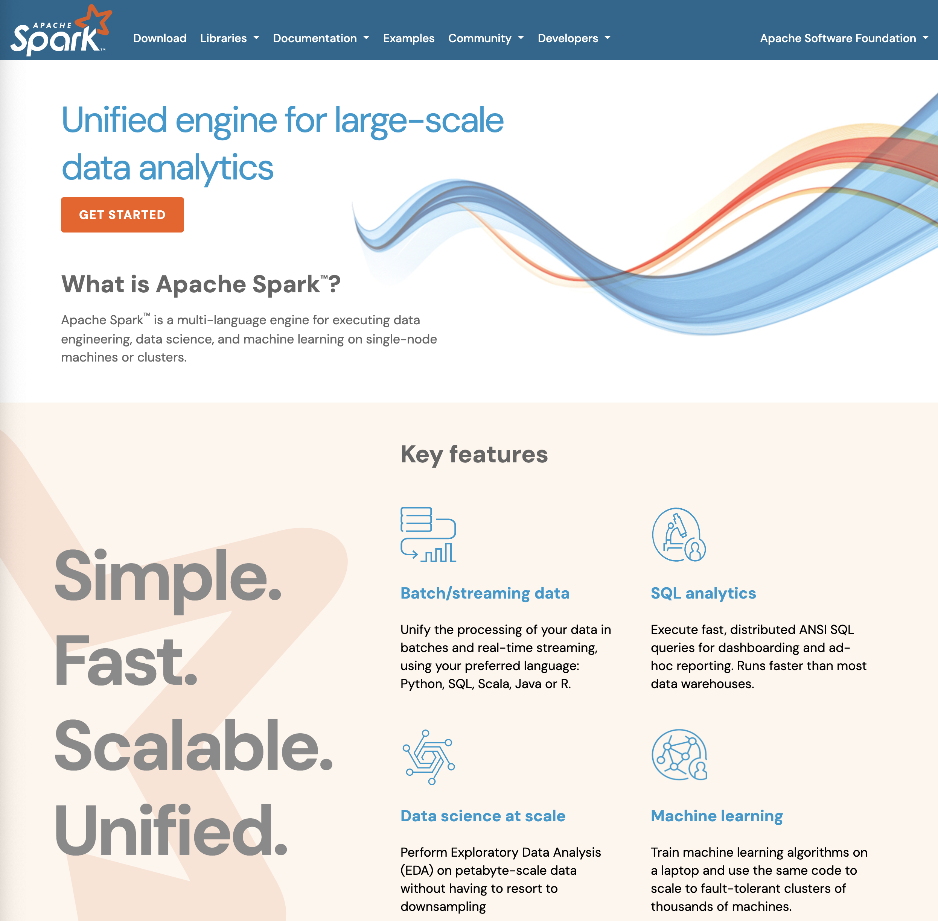

Slide 17
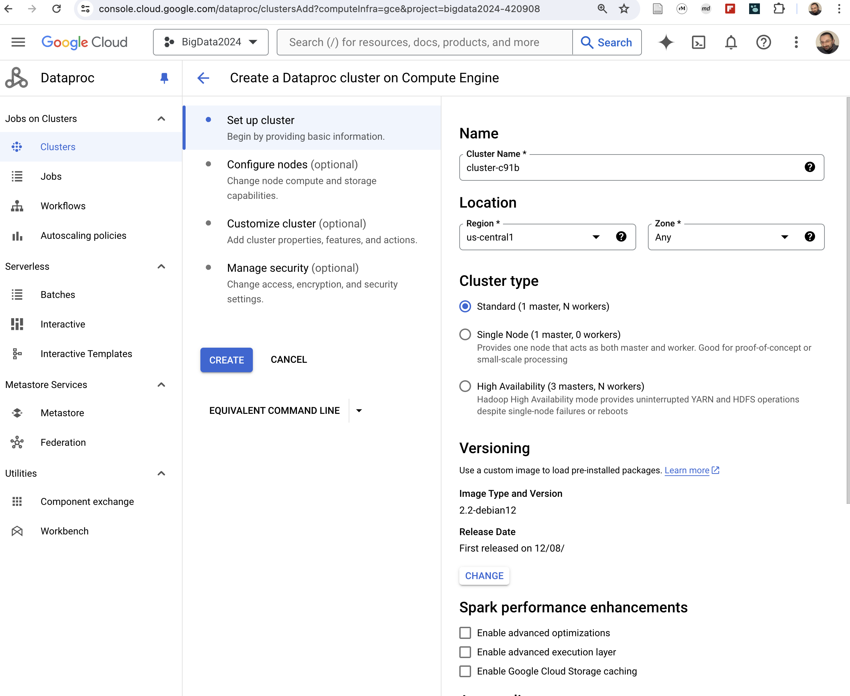

Slide 18
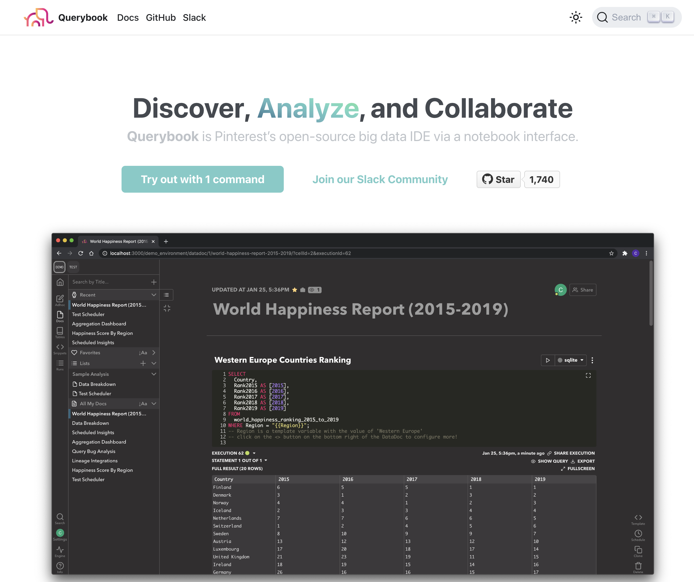

Slide 19
Pipelines

Slide 20
Logs, events, queries, etc.
Data queue
stream
Stream processing
Pipelines
Stream processing
Batch processing
(Stream and Batch Pipelines)
Logfiles, datasets, data bases, etc.
Storage
batch
Batch processing

Slide 21
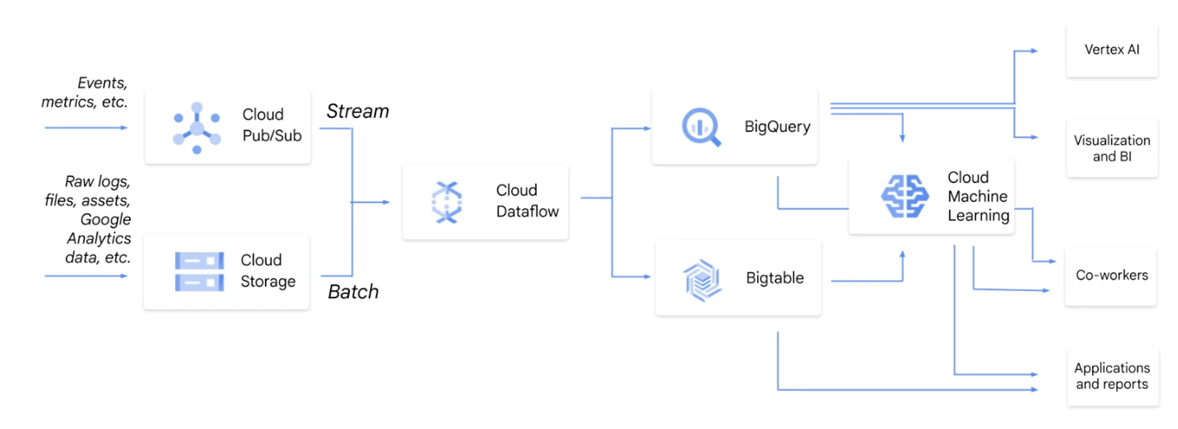
Cloud providers have dedicated solutions
Example: Google GCP

Slide 22
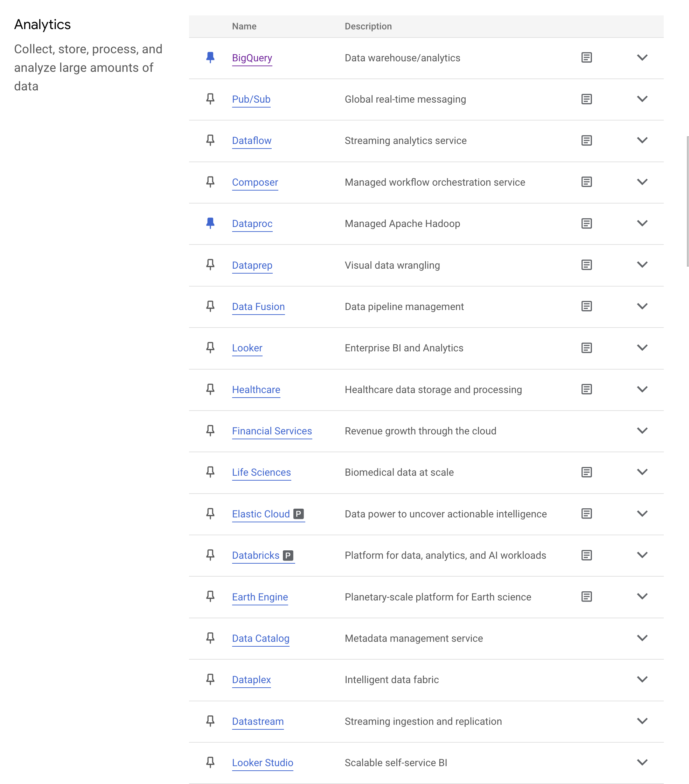
Cloud providers have dedicated solutions
Example: Google GCP

